Slide 1
Lecture: 4

Slide 2
Protocols
In computer networks, communication occurs between entities in different systems. An entity is anything capable of sending or receiving information.
Two entities cannot simply send bit streams to each other and expect to be understood. For communication to occur, the entities must agree on a protocol.
A protocol is a set of rules that govern data communications.

Slide 3
A protocol defines what is communicated, how it is communicated, and when it is communicated.

Slide 4
Syntax
The term syntax refers to the structure or format of the data, meaning the order in which they are presented.
For example, a simple protocol might expect the first 8 bits of data to be the address of the sender, the second 8 bits to be the address of the receiver, and the rest of the stream to be the message itself.

Slide 5
Semantics
The word semantics refers to the meaning of each section of bits.
How is a particular pattern to be interpreted, and what action is to be taken based on that interpretation? For example, does an address identify the route to be taken or the final destination of the message?

Slide 6
Timing
The term timing refers to two characteristics:
when data should be sent
how fast they can be sent
For example, if a sender produces data at 100 Mbps but the receiver can process data at only 1 Mbps, the transmission will overload the receiver and some data will be lost.

Slide 7
Standards
Standards are essential in creating and maintaining an open and competitive market for equipment manufacturers and in guaranteeing national and international interoperability of data and telecommunications technology and processes.

Slide 8
Data communication standards fall into two categories: de facto (meaning "by fact" or "by convention") and de jure (meaning "by law" or "by regulation").

Slide 9
De facto
Standards that have not been approved by an organized body but have been adopted as standards through widespread use are de facto standards. De facto standards are often established originally by manufacturers who seek to define the functionality of a new product or technology.

Slide 10
De jure
Those standards that have been legislated by an officially recognized body are de jure standards.

Slide 11
The driver's seat side in a given country starts as a user/industry preference, turning to a local tradition, then a traffic code local norm.

Slide 12
The QWERTY system was one of several options for the layout of letters on typewriter (and later keyboard) keys. It was developed to prevent adjacent keys from jamming on early and later mechanical typewriters, often attributed to the typist's speed. It became a de facto standard because it was used on the most commercially successful early typewriters.

Slide 13
HTML (computer file format) started as "de facto" (1993-1995) and became the "de jure" standard (1995–present day).

Slide 14
The ASCII text character set, standardized in 1963 is still in use. Document files containing ASCII have the TXT extension.

Slide 15
The MP3 audio format started as an alternative to CD WAV for Internet music distribution, then replaced it — it is now supported by the vast majority of music players, audio transport, audio storage and non-commercial media. WAV and MP3 are also "de jure ISO formats".

Slide 16
HTML (computer file format) started as "de facto" (1993-1995) and became the "de jure" standard (1995–present day).

Slide 17
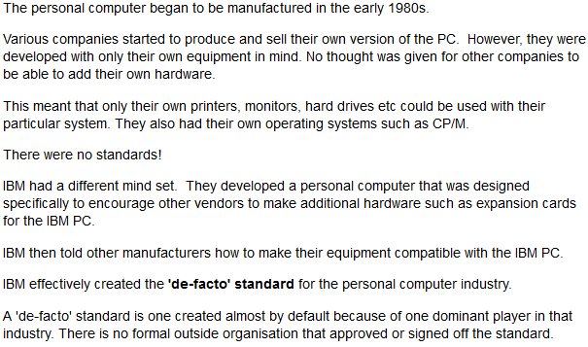

Slide 18
Assignment 1
Each group should Make a report on one particular De facto standards and submit the hard copy by 1st of June 2014.

Slide 19
Lecture 6
Next class: OSI model…

